Slide 1

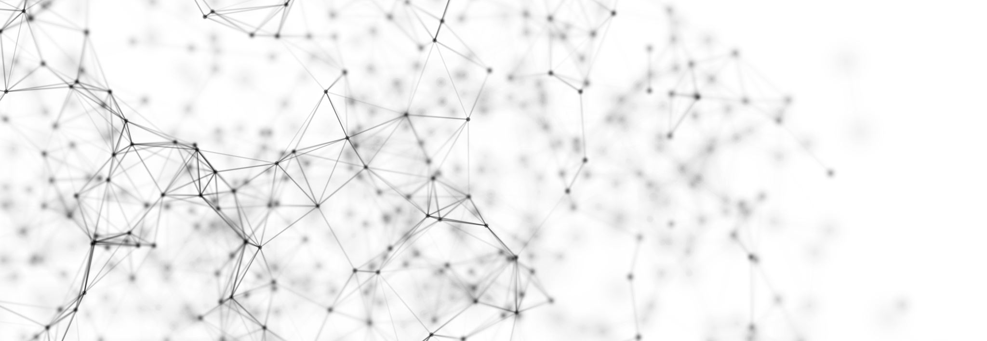


MMI DIP 세미나 week1
이용현
1

Slide 2

Index
Intensity transform
Affine transform
Color transform

Slide 3
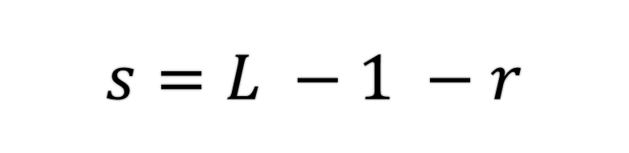
1. Intensity transform
a. Image negative
$$s=L −1 −r$$
Transform 후
intensity
Maximum of intensity level
Transform 전
intensity
그림1. Breast original image
그림2. After negative transform

Slide 4
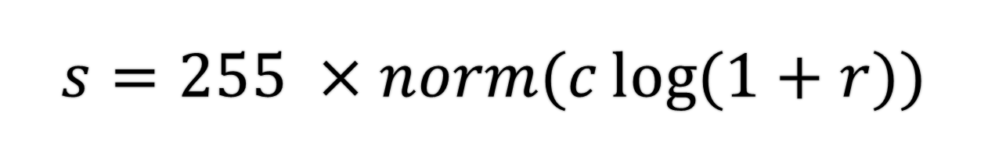
1. Intensity transform
b. Log transform
$$s=255 ×norm(c\log{(1+r))}$$
Intensity
after transform
Maximum = 1 , minimum = 0 으로 nomalize
Intensity
before transform
그림3. Fourier original image
그림4. After log transform

Slide 5
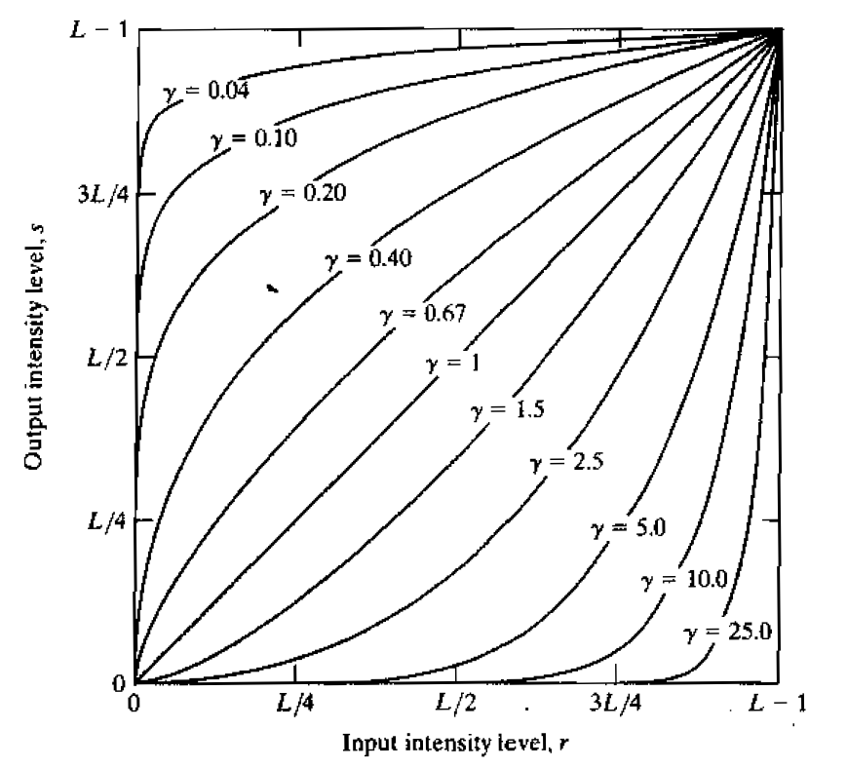

1. Intensity transform
c. Gamma transform
$$s=255 ×cr^{γ}$$
Gamma coefficient
Intensity
after transform
Nomalized intensity [0,1]
before transform
Increasing gamma coefficient upper 1, can make image dark
Decreasing gamma coefficient lower 1, can make image light
그림3. Gamma transform curve

Slide 6
1. Intensity transform
c. Gamma transform
그림5. MRI of human spine original image
그림6. Gamma transform
γ = 0.6
그림7. Gamma transform
γ = 0.4
그림8. Gamma transform
γ = 0.3

Slide 7
1. Intensity transform
c. Gamma transform
그림9. Aerial image
original image
그림10. Gamma transform
γ = 3.0
그림11. Gamma transform
γ = 4.0
그림12. Gamma transform
γ = 5.0

Slide 8
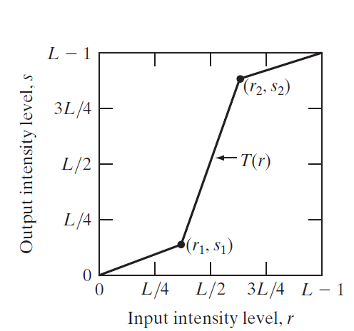
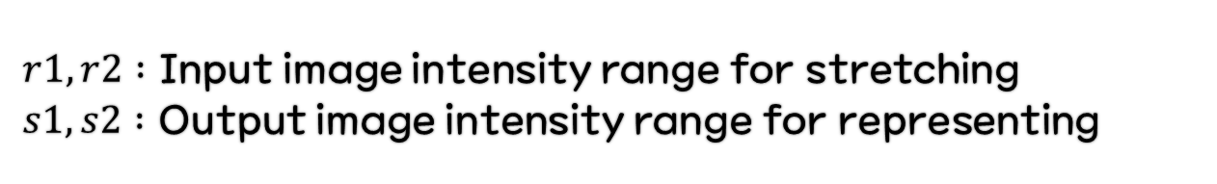
1. Intensity transform
d. Contrast stretching, thresholding
$r1,r2 :$ Input image intensity range for stretching
$s1,s2 :$ Output image intensity range for representing
그림13. Graph for contrast stretching
그림14. Low contrast image
그림15. Contrast stretching
(r1 = 80 r2 = 160 s1 = 0 s2 = 255)
그림16. Thresholding
(r1 =r2=median value
s1 = 0 s2 = 255)
그림4. After log transform
그림4. After log transform

Slide 9
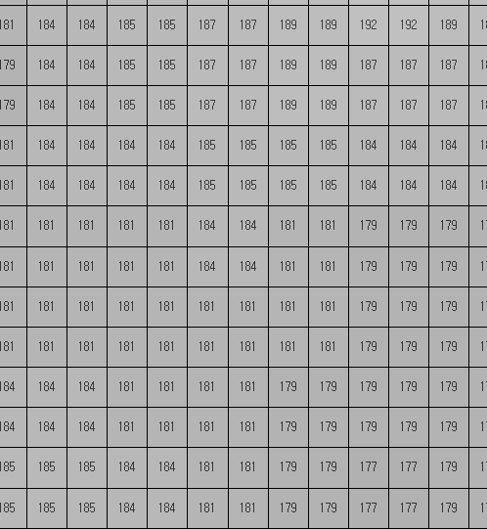
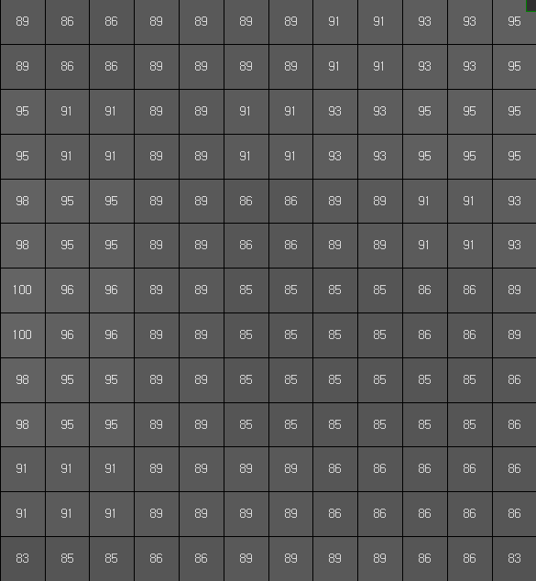
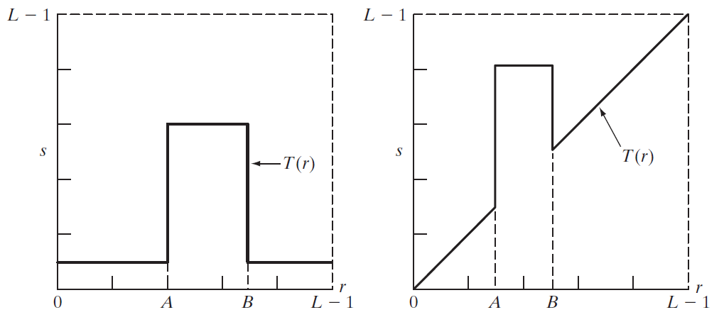
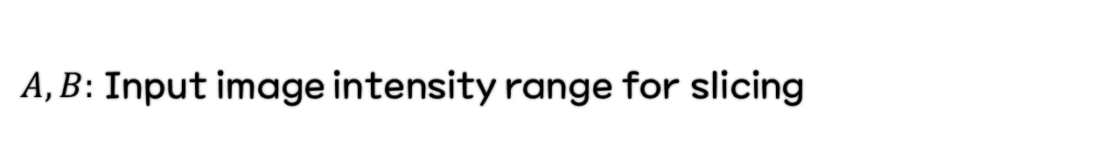
1. Intensity transform
e. Intensity-level slicing
$A,B:$ Input image intensity range for slicing
(a) (b)
그림17. Graph for intensity-level slicing
그림18. Kidney original image
그림19. After intensity-level slicing using (a)
(Intensity range = [150,230])
그림20. After intensity-level slicing using (b)
(Intensity range = [70,140])

Slide 10
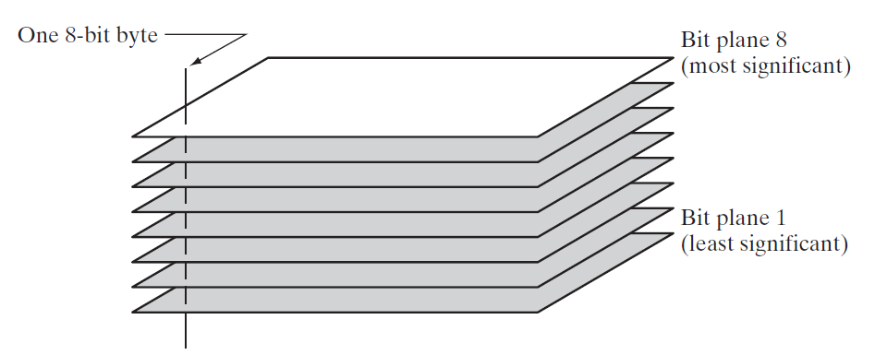
1. Intensity transform
For i in range(8)
f. Bit-plane slicing
$$Img\left[i\right]=img_{original} \& 2^{i}$$
그림21. Bit-plane representation of an 8-bit image
그림22. Dollar original image

Slide 11
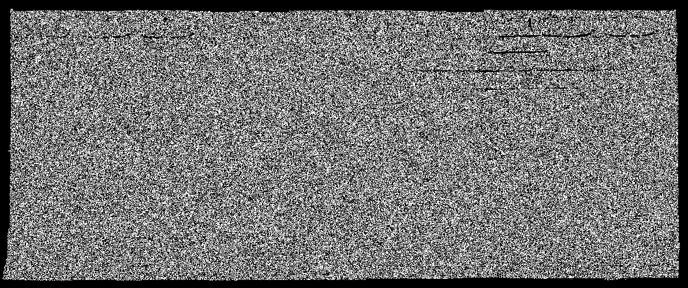
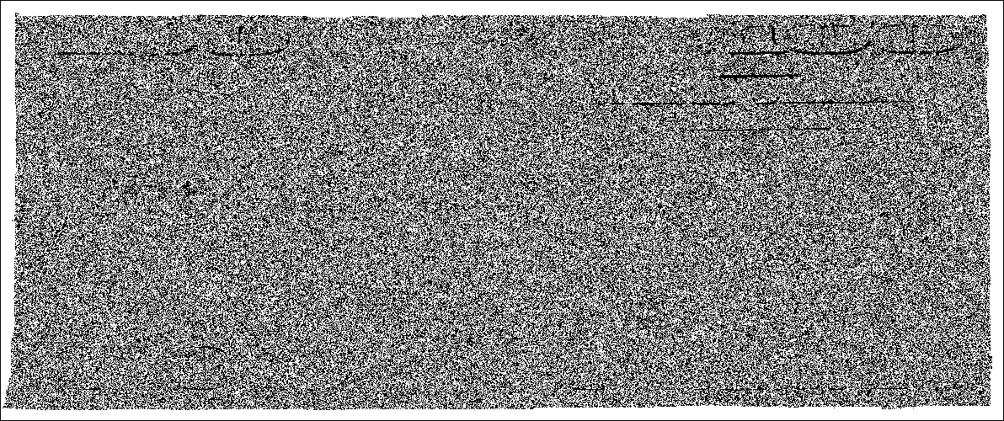
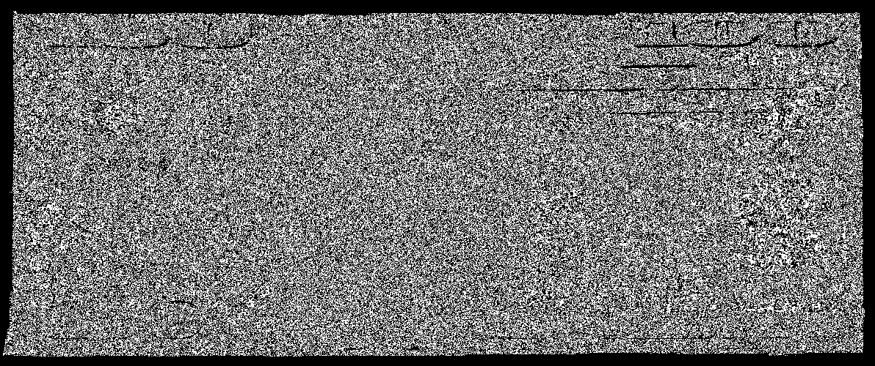
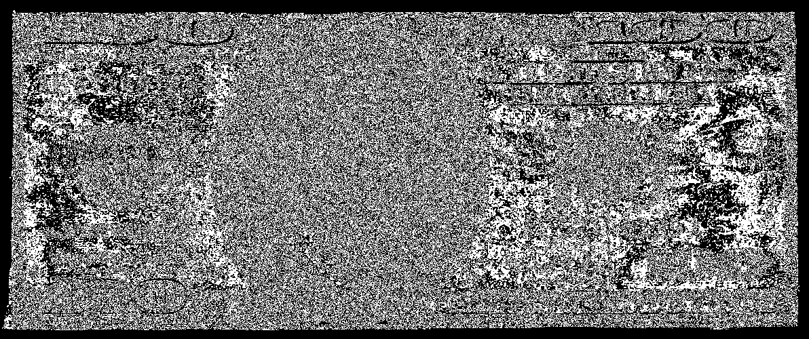
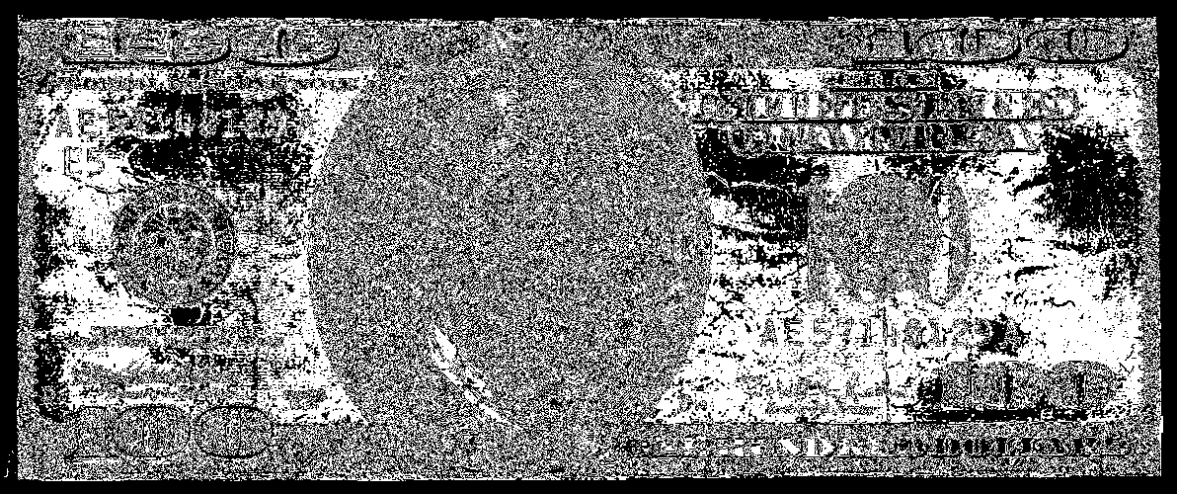
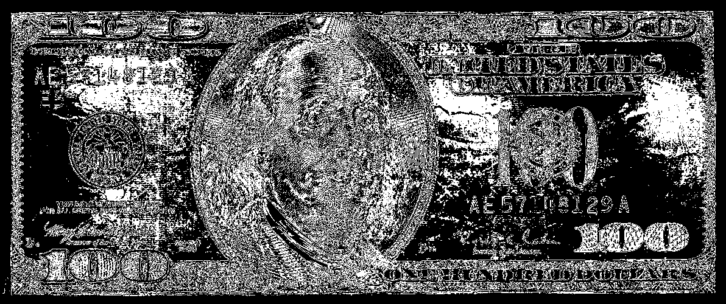
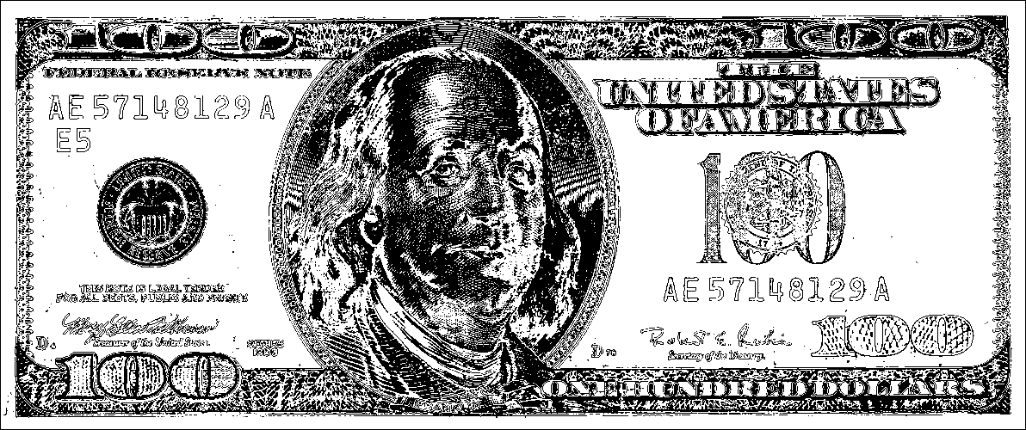
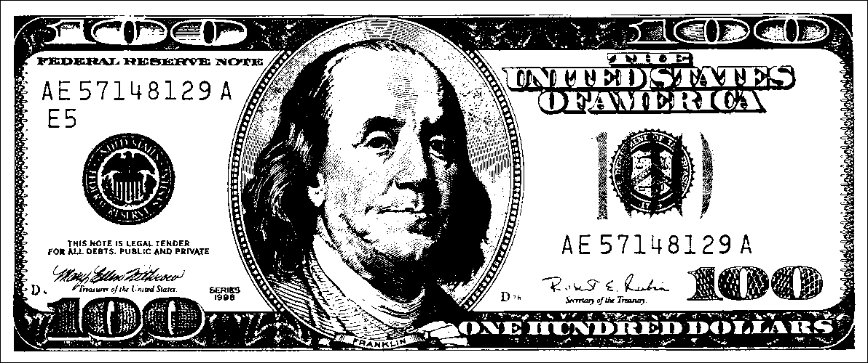
1. Intensity transform
f. Bit-plane slicing
그림23. Bit plane of dollar

Slide 12

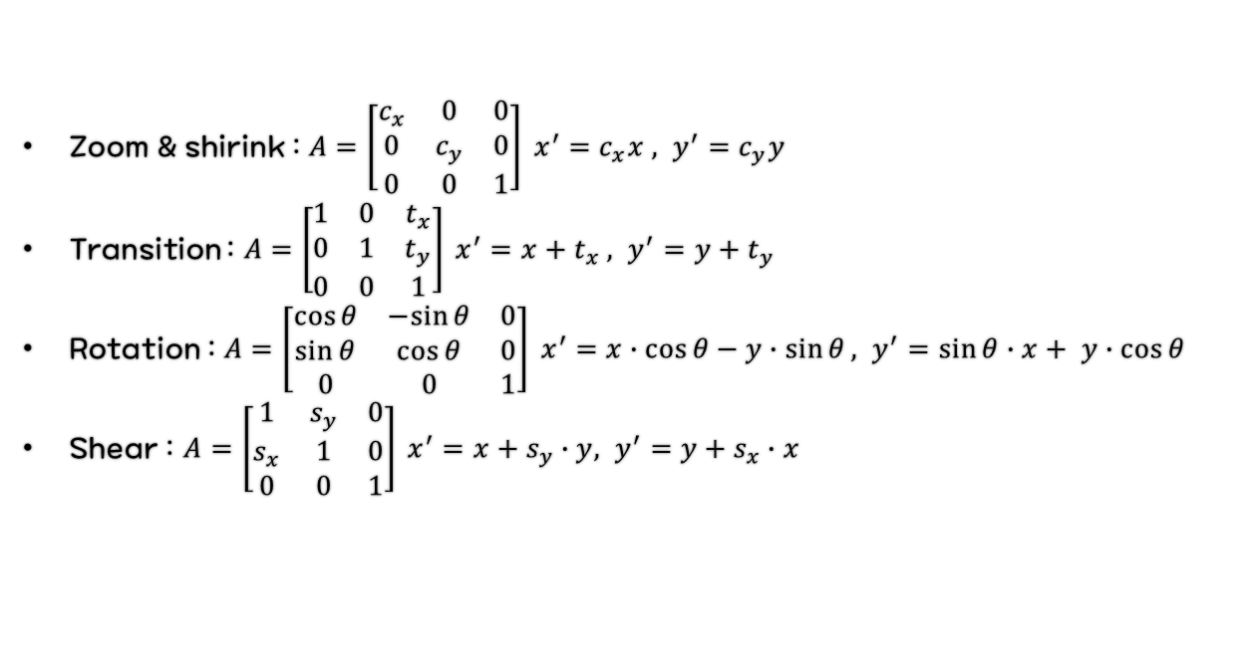
2. Affine transform
a. Theory – affine transform
$$\left[\begin{aligned}x^{′} \\ y^{′} \\ 1\end{aligned}\right]=A × \left[\begin{aligned}x \\ y \\ 1\end{aligned}\right]$$
Affine
Matrix
Output pixel
vector
Input pixel
vector
Zoom & shirink : $A=\left[\begin{matrix}c_{x} & 0 & 0 \\ 0 & c_{y} & 0 \\ 0 & 0 & 1\end{matrix}\right] x^{′}=c_{x}x , y^{′}=c_{y}y$
Transition : $A=\left[\begin{matrix}1 & 0 & t_{x} \\ 0 & 1 & t_{y} \\ 0 & 0 & 1\end{matrix}\right] x^{′}=x+t_{x} , y^{′}=y+t_{y}$
Rotation : $A=\left[\begin{matrix}\cos{θ} & −sin{θ} & 0 \\ \sin{θ} & \cos{θ} & 0 \\ 0 & 0 & 1\end{matrix}\right] x^{′}=x∙\cos{θ}−y∙\sin{θ}, y^{′}=\sin{θ}∙x+ y∙\cos{θ}$
Shear : $A=\left[\begin{matrix}1 & s_{y} & 0 \\ s_{x} & 1 & 0 \\ 0 & 0 & 1\end{matrix}\right] x^{′}=x+s_{y}∙y, y^{′}=y+s_{x}∙x$
Affine transform : geometric spatial transformation
Performed directly on the pixels
2021-01-28
12

Slide 13
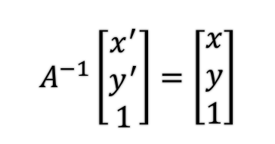
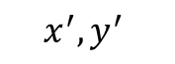

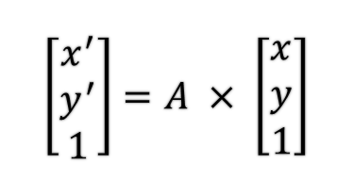
2. Affine transform
b. Theory – backward mapping & forward mapping
Inverse mapping
$$\left[\begin{aligned}x^{′} \\ y^{′} \\ 1\end{aligned}\right]=A × \left[\begin{aligned}x \\ y \\ 1\end{aligned}\right]$$
Forward mapping
$$A^{−1}\left[\begin{aligned}x^{′} \\ y^{′} \\ 1\end{aligned}\right]=\left[\begin{aligned}x \\ y \\ 1\end{aligned}\right]$$
★Pixel : discrete coordinate★
Need to find the intensity : interpolation
What intensity is
in this pixel(0.5 , 0)?
(0,0) 10 | (1,0) 50
(0,1) 60 | (1,1) 255
2x zoom
(0,0) 10 | (1,0) ? | (2,0) 50 | (3,0) ?
(0,1) ? | (1,1) ? | (2,1) ? | (3,1) ?
(0,2) 60 | (1,2) ? | (2,2) 255 | (3,2) ?
(0,3) ? | (1,3) ? | (2,3) ? | (3,3) ?
(0,0) 10 | (1,0) ? | (2,0) 50 | (3,0) ?
(0,1) ? | (1,1) ? | (2,1) ? | (3,1) ?
(0,2) 60 | (1,2) ? | (2,2) 255 | (3,2) ?
(0,3) ? | (1,3) ? | (2,3) ? | (3,3) ?
(0,0) 10 | (1,0) 50
(0,1) 60 | (1,1) 255
(0.5,0)
$$x,y$$
Input image
Input image
$$x^{′},y^{′}$$
Output image
Output image
2021-01-28
13

Slide 14
2. Affine transform
c. Theory – interpolation
Nearest interpolation : determine the value from rounding off to the nearest integer
(0,0) 10 | (1,0) ? | (2,0) 50 | (3,0) ?
(0,1) ? | (1,1) ? | (2,1) ? | (3,1) ?
(0,2) 60 | (1,2) ? | (2,2) 255 | (3,2) ?
(0,3) ? | (1,3) ? | (2,3) ? | (3,3) ?
(0,0) 10 | (1,0) 50
(0,1) 60 | (1,1) 255
(0,0) 10 | (1,0) 50 | (2,0) 50 | (3,0) 50
(0,1) 60 | (1,1) 255 | (2,1) 255 | (3,1) 255
(0,2) 60 | (1,2) 255 | (2,2) 255 | (3,2) 255
(0,3) 60 | (1,3) 255 | (2,3) 255 | (3,3) 255
(0.5,0)
= (1,0) = 50
2021-01-28
14

Slide 15
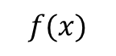
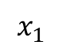
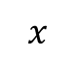
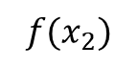
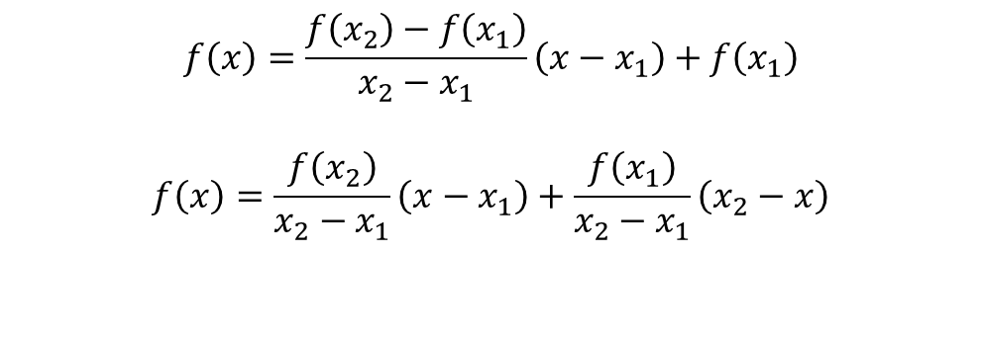
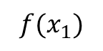
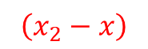
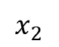
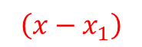
2. Affine transform
c. Theory – interpolation
Bilinear interpolation : determine the value using linear equation
$$f(x_{2})$$
$$f\left(x\right)=\frac{f\left(x_{2}\right)−f\left(x_{1}\right)}{x_{2}−x_{1}}\left(x−x_{1}\right)+f\left(x_{1}\right)$$
$$f\left(x\right)=\frac{f\left(x_{2}\right)}{x_{2}−x_{1}}\left(x−x_{1}\right)+\frac{f\left(x_{1}\right)}{x_{2}−x_{1}}\left(x_{2}−x\right)$$
$$f(x)$$
$$f(x_{1})$$
$$\left(x−x_{1}\right)$$
$$\left(x_{2}−x\right)$$
Use weight
$$x_{1}$$
$$x$$
$$x_{2}$$
2021-01-28
15

Slide 16

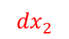
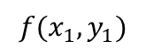
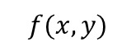
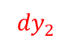
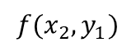
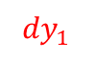
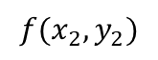
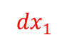
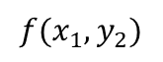

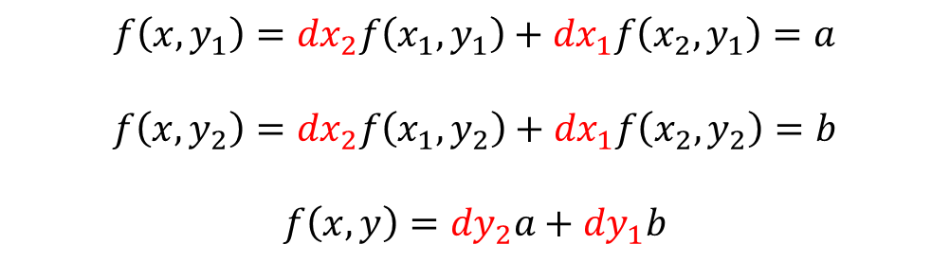
2. Affine transform
c. Theory – interpolation
Bilinear interpolation : determine the value using linear equation
$$\left(x−x_{1}\right)$$
$$\left(x_{2}−x\right)$$
$${f(x}_{1},y_{1})$$
$${f(x}_{2},y_{1})$$
$${dy}_{1}$$
$$f\left(x,y_{1}\right)={dx}_{2}f\left(x_{1},y_{1}\right)+{dx}_{1}f\left(x_{2},y_{1}\right)=a$$
$$f\left(x,y_{2}\right)={dx}_{2}f\left(x_{1},y_{2}\right)+{dx}_{1}f\left(x_{2},y_{2}\right)=b$$
$$f\left(x,y\right)={dy}_{2}a+{dy}_{1}b$$
$$f(x,y)$$
$${dy}_{2}$$
$${dx}_{1}$$
$${dx}_{2}$$
$${f(x}_{1},y_{2})$$
$${f(x}_{2},y_{2})$$
2021-01-28
16

Slide 17
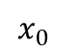
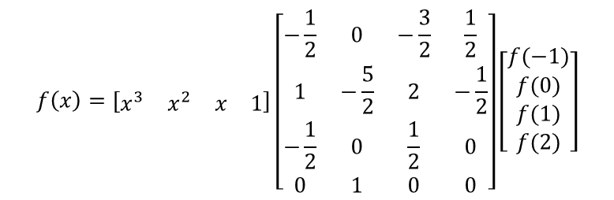
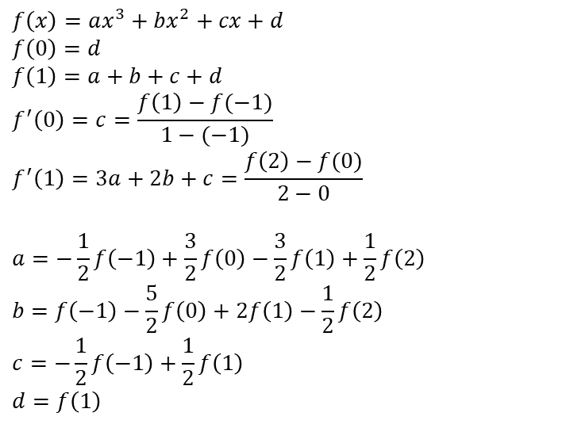
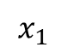
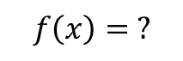
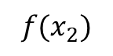
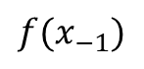
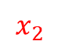



2. Affine transform
c. Theory – interpolation
Bicubic interpolation : determine the value using third degree polynomial
$$f\left(x\right)=ax^{3}+bx^{2}+cx+d$$
$$f\left(0\right)=d$$
$$f\left(1\right)=a+b+c+d$$
$$f^{′}\left(0\right)=c=\frac{f\left(1\right)−f(−1)}{1−(−1)}$$
$$f^{′}\left(1\right)=3a+2b+c=\frac{f\left(2\right)−f(0)}{2−0}$$
$$a=−\frac{1}{2}f\left(−1\right)+\frac{3}{2}f\left(0\right)−\frac{3}{2}f\left(1\right)+\frac{1}{2}f\left(2\right)$$
$$b=f\left(−1\right)−\frac{5}{2}f\left(0\right)+2f\left(1\right)−\frac{1}{2}f\left(2\right)$$
$$c=−\frac{1}{2}f\left(−1\right)+\frac{1}{2}f\left(1\right)$$
$$d=f\left(1\right)$$
$$f(x_{−1})$$
$$f(x_{0})$$
$$f\left(x\right)=\left[\begin{matrix}x^{3} & x^{2} & x & 1\end{matrix}\right]\left[\begin{matrix}−\frac{1}{2} & 0 & −\frac{3}{2} & \frac{1}{2} \\ 1 & −\frac{5}{2} & 2 & −\frac{1}{2} \\ −\frac{1}{2} & 0 & \frac{1}{2} & 0 \\ 0 & 1 & 0 & 0\end{matrix}\right]\left[\begin{aligned}f(−1) \\ f(0) \\ f(1) \\ f(2)\end{aligned}\right]$$
$$f\left(x\right)= ?$$
$$f(x_{1})$$
$$f(x_{2})$$
$$x_{−1}$$
$$x_{0}$$
$$x_{1}$$
$$x_{2}$$
2021-01-28
17

Slide 18







2. Affine transform
c. Theory – interpolation
Bilinear interpolation : determine the value using linear equation
$$f\left(x,y_{−1}\right)=\left[\begin{matrix}x^{3} & x^{2} & x & 1\end{matrix}\right]\left[\begin{matrix}−\frac{1}{2} & 0 & −\frac{3}{2} & \frac{1}{2} \\ 1 & −\frac{5}{2} & 2 & −\frac{1}{2} \\ −\frac{1}{2} & 0 & \frac{1}{2} & 0 \\ 0 & 1 & 0 & 0\end{matrix}\right]\left[\begin{aligned}f(x_{−1},y_{−1}) \\ f(x_{0},y_{−1}) \\ f(x_{1},y_{−1}) \\ f(x_{2},y_{−1})\end{aligned}\right]$$
$${f(x}_{−1},y_{−1})$$
$${f(x}_{2},y_{−1})$$
…
$$f\left(x,y_{0}\right)$$
$$f\left(x,y_{1}\right)$$
$$f\left(x,y_{2}\right)$$
…
$$f\left(x,y \right)$$
$$f(x,y)$$
$${f(x}_{−1},y_{2})$$
$${f(x}_{2},y_{2})$$
2021-01-28
18

Slide 19



2. Affine transform
d. Application – rotation + shift
θ
$$x^{′}=\cos{θ∙}\left(x−a\right)−\sin{θ}∙\left(y−b\right)+a$$
$$y^{′}=\sin{θ}∙\left(x−a\right)+\cos{θ}∙\left(y−b\right)+b$$
$$A=\left[\begin{matrix}\cos{θ} & −\sin{θ} & −a\cos{θ}+b\sin{θ}+a \\ \sin{θ} & \cos{θ} & −a\sin{θ}−b\cos{θ}+b \\ 0 & 0 & 1\end{matrix}\right]$$
(a,b)
θ
$$\left(x,y\right)$$
$$\left(x^{′},y^{′}\right)$$
2021-01-28
19

Slide 20
2. Affine transform
e. Results
그림24. Original T image
그림25. Translation (100,300)
2021-01-28
20

Slide 21



2. Affine transform
e. Results
그림26. 30˚ Rotation,
nearest neighborhood
그림27. 30˚ Rotation, bilinear
그림28. 30˚ Rotation, bicubic
2021-01-28
21

Slide 22



2. Affine transform
e. Results
그림29. x = 2배 y = 1.5배 zoom,
nearest neighborhood
그림30. x = 2배 y = 1.5배 zoom, bilinear
그림31. x = 2배 y = 1.5배 zoom, bicubic
2021-01-28
22

Slide 23
2. Affine transform
e. Results
그림32. x = 1.2 y = 1.5 shear,
nearest neighborhood
그림33. x = 1.2 y = 1.5 shear, bilinear
그림34. x = 1.2 y = 1.5 shear, bicubic
2021-01-28
23

Slide 24
3. Color transform
a. RGB, HSI
RGB color space : From three additive primary colors
For sensing, representation and display of images
Device-dependent color model
HSI color space : Designed like the way human vision perceives color
2021-01-28
24

Slide 25


3. Color transform
a. RGB, HSI
그림35. RGB color space
그림36. HSI color space
2021-01-28
25

Slide 26
3. Color transform
b. HSI color space
H : Hue (색조) (radian or angle)
그림37. strawberry original image
S : Saturation (distance from the center)
그림38. strawberry transformed H x 0.8
I : Intensity (lightness)
그림39. strawberry transformed S x 0.5
그림40. strawberry transformed I x 0.5
2021-01-28
26

Slide 27




3. Color transform
c. RGB to HSI
그림41. RGB to HSI color cube
그림42. RGB to HSI color cube - hue
그림43. RGB to HSI color cube - saturation
그림44. RGB to HSI color cube intensity
2021-01-28
27

Slide 28
3. Color transform
d. HSI to RGB
그림45. HSI to RGB color cube
그림46. HSI to RGB color cube - Blue
그림47. HSI to RGB color cube - Green
그림48. HSI to RGB color cube - Red
2021-01-28
28

